Slide 1

CAP 6317/4773: Social Media Mining
Lecture 18: Assortativity: Homophily and Influence
Raiyan Abdul Baten, Ph.D.
March 26, 2024

Slide 2
Recap

Slide 3
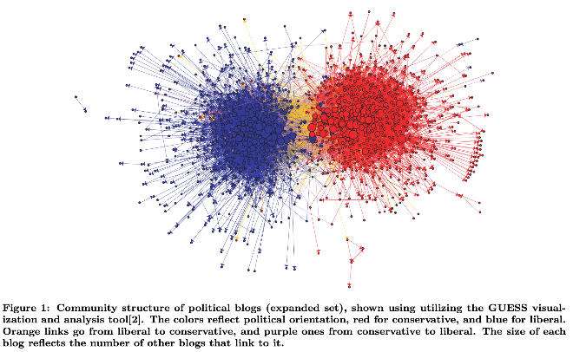
Unsupervised Learning Tasks on Graphs

Slide 4
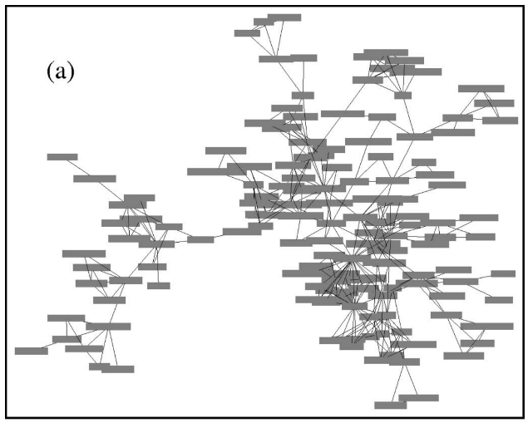
Newman, Mark EJ, and Michelle Girvan. "Finding and evaluating community structure in networks." Physical review E 69.2 (2004): 026113.

Slide 5
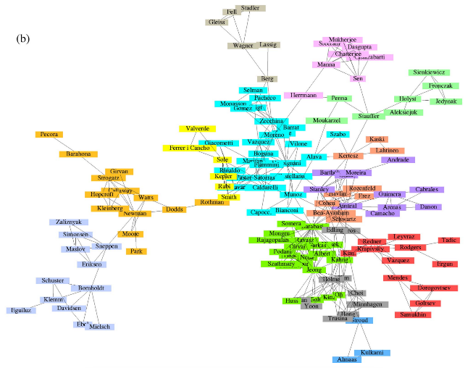
Newman, Mark EJ, and Michelle Girvan. "Finding and evaluating community structure in networks." Physical review E 69.2 (2004): 026113.

Slide 6
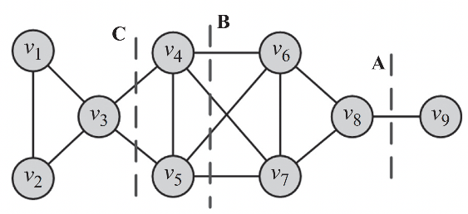
Minimum Cut
A cut in a graph is a partitioning (cut) of the graph into two (or more) sets.
The size of the cut is the number of edges that are being cut
How do we partition the graph below into two with the least cut size?

Slide 7
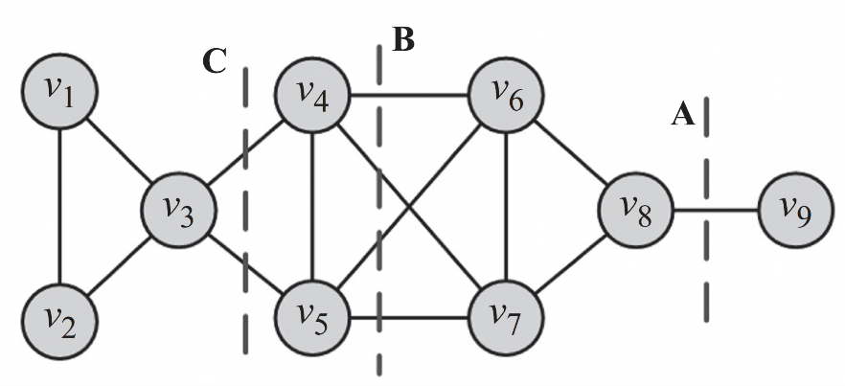
Minimum Cut

Slide 8

Ratio Cut
Ratio cut:
Minimize
P₁
P₂

Slide 9
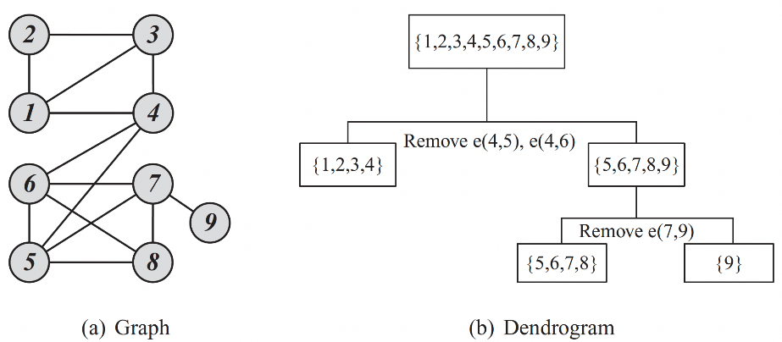
Divisive Hierarchical Clustering: Girvan-Newman Algorithm

Slide 10
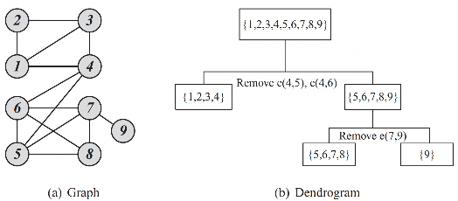
Divisive Hierarchical Clustering: Girvan-Newman Algorithm
Calculate edge betweenness for all edges in the graph
Remove the edge with the highest edge betweenness
Recalculate betweenness for all edges affected by the edge removal
Repeat until all edges are removed

Slide 11
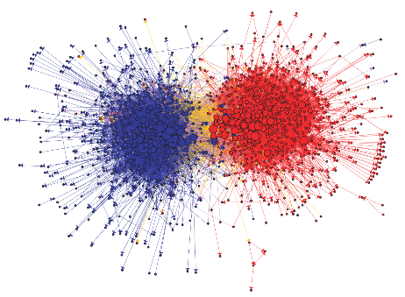
Spectral Clustering
Binary splits a graph into k = 2 clusters
Repeat to get 4, 8, 16 clusters.

Slide 12

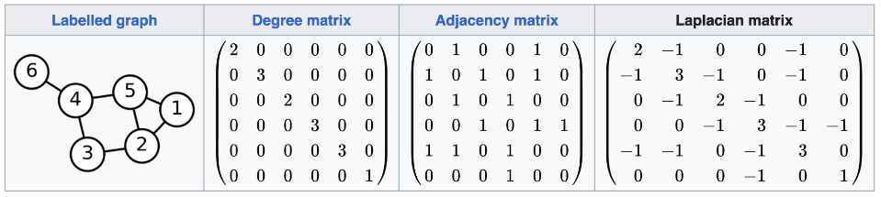
A Detour on the Graph Laplacian

Slide 13
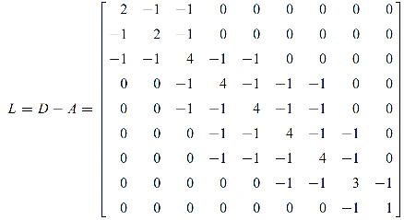
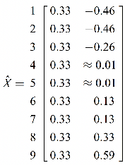
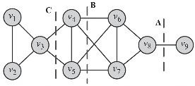
Binary partitioning of graphs then becomes extremely easy:
Take the 2nd smallest Eigenvector associated with λ₂(L)
The signs of the entries of this Eigenvector tell you which node belongs to which cluster!

Slide 14
Questions?

Slide 15
Pop Quiz

Slide 16
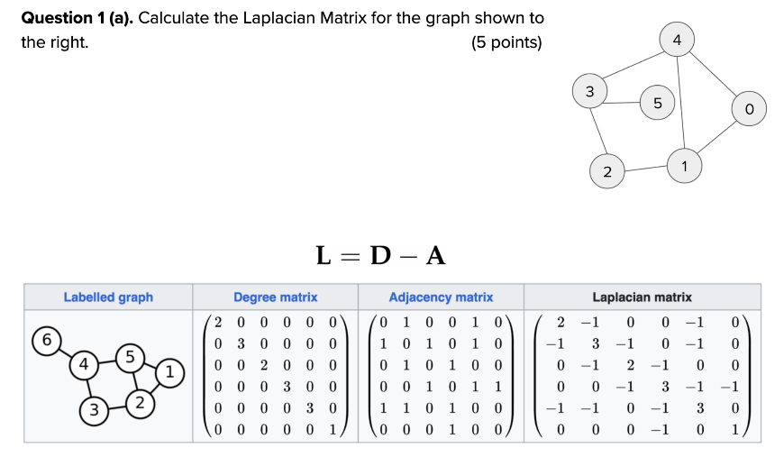

Slide 17
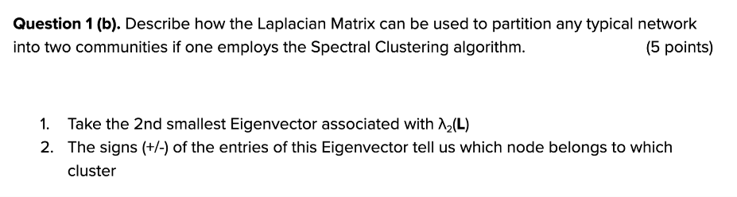

Slide 18
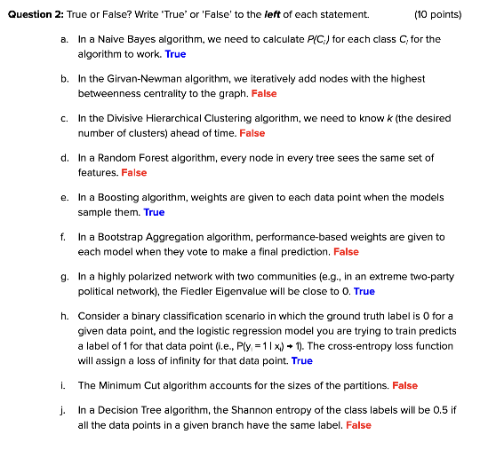

Slide 19
Reminder to self: Attendance

Slide 20
Readings for today’s class: Chapter 8

Slide 21
Assortativity

Slide 23
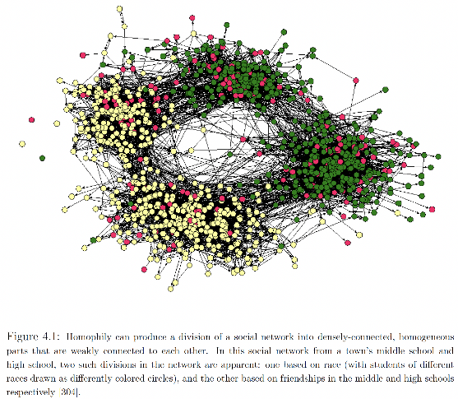
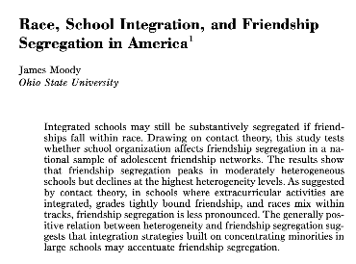

Slide 24
Assortativity
Similar nodes are connected to one another more often than dissimilar nodes.

Slide 25
Assortativity
Similar nodes are connected to one another more often than dissimilar nodes.
Example: Friendship network
Similar behavior
Similar interests
Similar activities
Similar beliefs
Shared attributes such as language, age, gender, location etc.

Slide 26
Assortativity
Similar nodes are connected to one another more often than dissimilar nodes.
Example: Friendship network
Similar behavior
Similar interests
Similar activities
Similar beliefs
Shared attributes such as language, age, gender, location etc.
Let’s ignore the underlying causal mechanisms for now, and analyze a network ‘snapshot’ for assortativity.

Slide 27
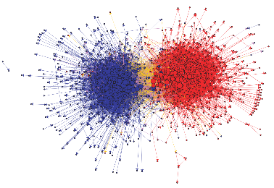
Intuition
If ‘similar’ people have more edges between them than random chance, we know assortativity is happening.

Slide 28
Intuition
If ‘similar’ people have more edges between them than random chance, we know assortativity is happening.
‘Dissimilar’ people may also have more edges between them than random chance: reverse assortativity! Example?

Slide 29
Intuition
If ‘similar’ people have more edges between them than random chance, we know assortativity is happening.
‘Dissimilar’ people may also have more edges between them than random chance: reverse assortativity! Example?
The Modularity metric, Q, captures these intuitions.

Slide 30
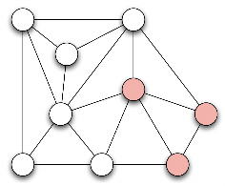
Modularity
Q = (Fraction of edges between nodes of the same type) -­ (Expected fraction of edges between nodes of the same type due to random chance)
Positive values: We have assortativity
Negative values: We have reverse assortativity

Slide 31
Modularity
Let t(v_{i} ) denote the ‘type’ of node v_{i}

Slide 32
Modularity
Let t(v_{i} ) denote the ‘type’ of node v_{i}
We have an assortative tie between v_{i} and v_{j} when t(v_{i} ) = t(v_{j} )

Slide 33

Modularity
Let t(v_{i} ) denote the ‘type’ of node v_{i}
We have an assortative tie between v_{i} and v_{j} when t(v_{i} ) = t(v_{j} )
To mathematically capture this, let us use the Kronecker’s delta function:

Slide 34
Modularity
Let t(v_{i} ) denote the ‘type’ of node v_{i}
We have an assortative tie between v_{i} and v_{j} when t(v_{i} ) = t(v_{j} )
To mathematically capture this, let us use the Kronecker’s delta function:
Thus, if v_{i} and v_{j} have the same type, δ( t(v_{i} ) , t(v_{j} ) ) = 1

Slide 35
Modularity
Let t(v_{i} ) denote the ‘type’ of node v_{i}
We have an assortative tie between v_{i} and v_{j} when t(v_{i} ) = t(v_{j} )
To mathematically capture this, let us use the Kronecker’s delta function:
Thus, if v_{i} and v_{j} have the same type, δ( t(v_{i} ) , t(v_{j} ) ) = 1
Intuition: Are the nodes of the same type? Kronecker delta will respond with a simple yes (1) /no (0) answer.

Slide 36

Modularity
Q = (Fraction of edges between nodes of the same type) -­ (Expected fraction of edges between nodes of the same type due to random chance)
Fraction of edges between nodes of the same type
=

Slide 37

Modularity
Q = (Fraction of edges between nodes of the same type) -­ (Expected fraction of edges between nodes of the same type due to random chance)
Fraction of edges between nodes of the same type
=
m is the total number of edges in the graph, used here for normalization

Slide 38
Modularity
Q = (Fraction of edges between nodes of the same type) -­ (Expected fraction of edges between nodes of the same type due to random chance)
Fraction of edges between nodes of the same type
=
Consider one edge at a time

Slide 39
Modularity
Q = (Fraction of edges between nodes of the same type) -­ (Expected fraction of edges between nodes of the same type due to random chance)
Fraction of edges between nodes of the same type
=
Check whether the nodes connected by the edge are of the same type. If yes, the Kronecker delta will return 1.

Slide 40

Modularity
Q = (Fraction of edges between nodes of the same type) -­ (Expected fraction of edges between nodes of the same type due to random chance)
Fraction of edges between nodes of the same type
=
=

Slide 41
Modularity
Q = (Fraction of edges between nodes of the same type) -­ (Expected fraction of edges between nodes of the same type due to random chance)
Fraction of edges between nodes of the same type
=
=
Let us sum over all i,j index combinations

Slide 42
Modularity
Q = (Fraction of edges between nodes of the same type) -­ (Expected fraction of edges between nodes of the same type due to random chance)
Fraction of edges between nodes of the same type
=
=
If nodes v_{i} and v_{j} are linked, A_{ij} = 1

Slide 43
Modularity
Q = (Fraction of edges between nodes of the same type) -­ (Expected fraction of edges between nodes of the same type due to random chance)
Fraction of edges between nodes of the same type
=
=
We are counting each edge twice in this undirected graph (A_{ij} and A_{ji} ), so divide by 2

Slide 44

Modularity
What is the expected number of edges between two nodes due to random chance?
v_{i}
v_{j}

Slide 45
Modularity
What is the expected number of edges between two nodes due to random chance?
Let d_{i} and d_{j} denote degrees of v_{i} and v_{j}
v_{i}
v_{j}

Slide 46
Modularity
What is the expected number of edges between two nodes due to random chance?
Let d_{i} and d_{j} denote degrees of v_{i} and v_{j}
There are m edges in the network, which have 2m ‘endpoints’ where a node can attach itself.
v_{i}
v_{j}

Slide 47
Modularity
What is the expected number of edges between two nodes due to random chance?
Let d_{i} and d_{j} denote degrees of v_{i} and v_{j}
There are m edges in the network, which have 2m ‘endpoints’ where a node can attach itself.
Out of those 2m endpoints, d_{j} endpoints belong to node j.
v_{i}
v_{j}

Slide 48
Modularity
What is the expected number of edges between two nodes due to random chance?
Let d_{i} and d_{j} denote degrees of v_{i} and v_{j}
There are m edges in the network, which have 2m ‘endpoints’ where a node can attach itself.
Out of those 2m endpoints, d_{j} endpoints belong to node j.
So, due to random chance, one edge of v_{i} has chance of attaching to v_{j} .
v_{i}
v_{j}

Slide 49

Modularity
What is the expected number of edges between two nodes due to random chance?
Let d_{i} and d_{j} denote degrees of v_{i} and v_{j}
There are m edges in the network, which have 2m ‘endpoints’ where a node can attach itself.
Out of those 2m endpoints, d_{j} endpoints belong to node j.
So, due to random chance, one edge of v_{i} has chance of attaching to v_{j} .
Since v_{i} has d_{i} edges, the expected number of edges between v_{i} and v_{j} becomes
v_{i}
v_{j}

Slide 50

Modularity
Q = (Fraction of edges between nodes of the same type) -­ (Expected fraction of edges between nodes of the same type due to random chance)
Expected fraction of edges between nodes of the same type due to random chance
=
Sum over all i,j combinations

Slide 51
Modularity
Q = (Fraction of edges between nodes of the same type) -­ (Expected fraction of edges between nodes of the same type due to random chance)
Expected fraction of edges between nodes of the same type due to random chance
=
Expected number of edges between v_{i} and v_{j}

Slide 52
Modularity
Q = (Fraction of edges between nodes of the same type) -­ (Expected fraction of edges between nodes of the same type due to random chance)
Expected fraction of edges between nodes of the same type due to random chance
=
Check whether v_{i} and v_{j} are of the same type

Slide 53

Modularity
Q = (Fraction of edges between nodes of the same type) -­ (Expected fraction of edges between nodes of the same type due to random chance)
=

Slide 54

Modularity
Q = (Fraction of edges between nodes of the same type) -­ (Expected fraction of edges between nodes of the same type due to random chance)
=
=

Slide 55
Summary

